Slide 1
Welcome to the P&M Technical Session
Dr. Joshua Piehl Mechanical Engineer, US Army DEVCOM – GVSC
Thomas Trzaska Director, Strategic Technology, RENK America (Retired)
Porfirio Nogueiro Technical Fellow, BAE Systems
Isaac Rife Program Engineering Manager, BAE Systems
Dr. Eric Gingrich Specialist Research Engineer, US ARMY DEVCOM - GVSC

Slide 2

Published Paper Access
Use the link or scan the QR code below for access to today’s published papers.
- Papers can be found next in the agenda next to their respective session
Papers will be available through SAE in September.
https://www.ndia-mich.org/gvsets/agenda

Slide 3

GVSETS Technical Paper Archive
https://saemobilus.sae.org/
Search “ndia”

Slide 4
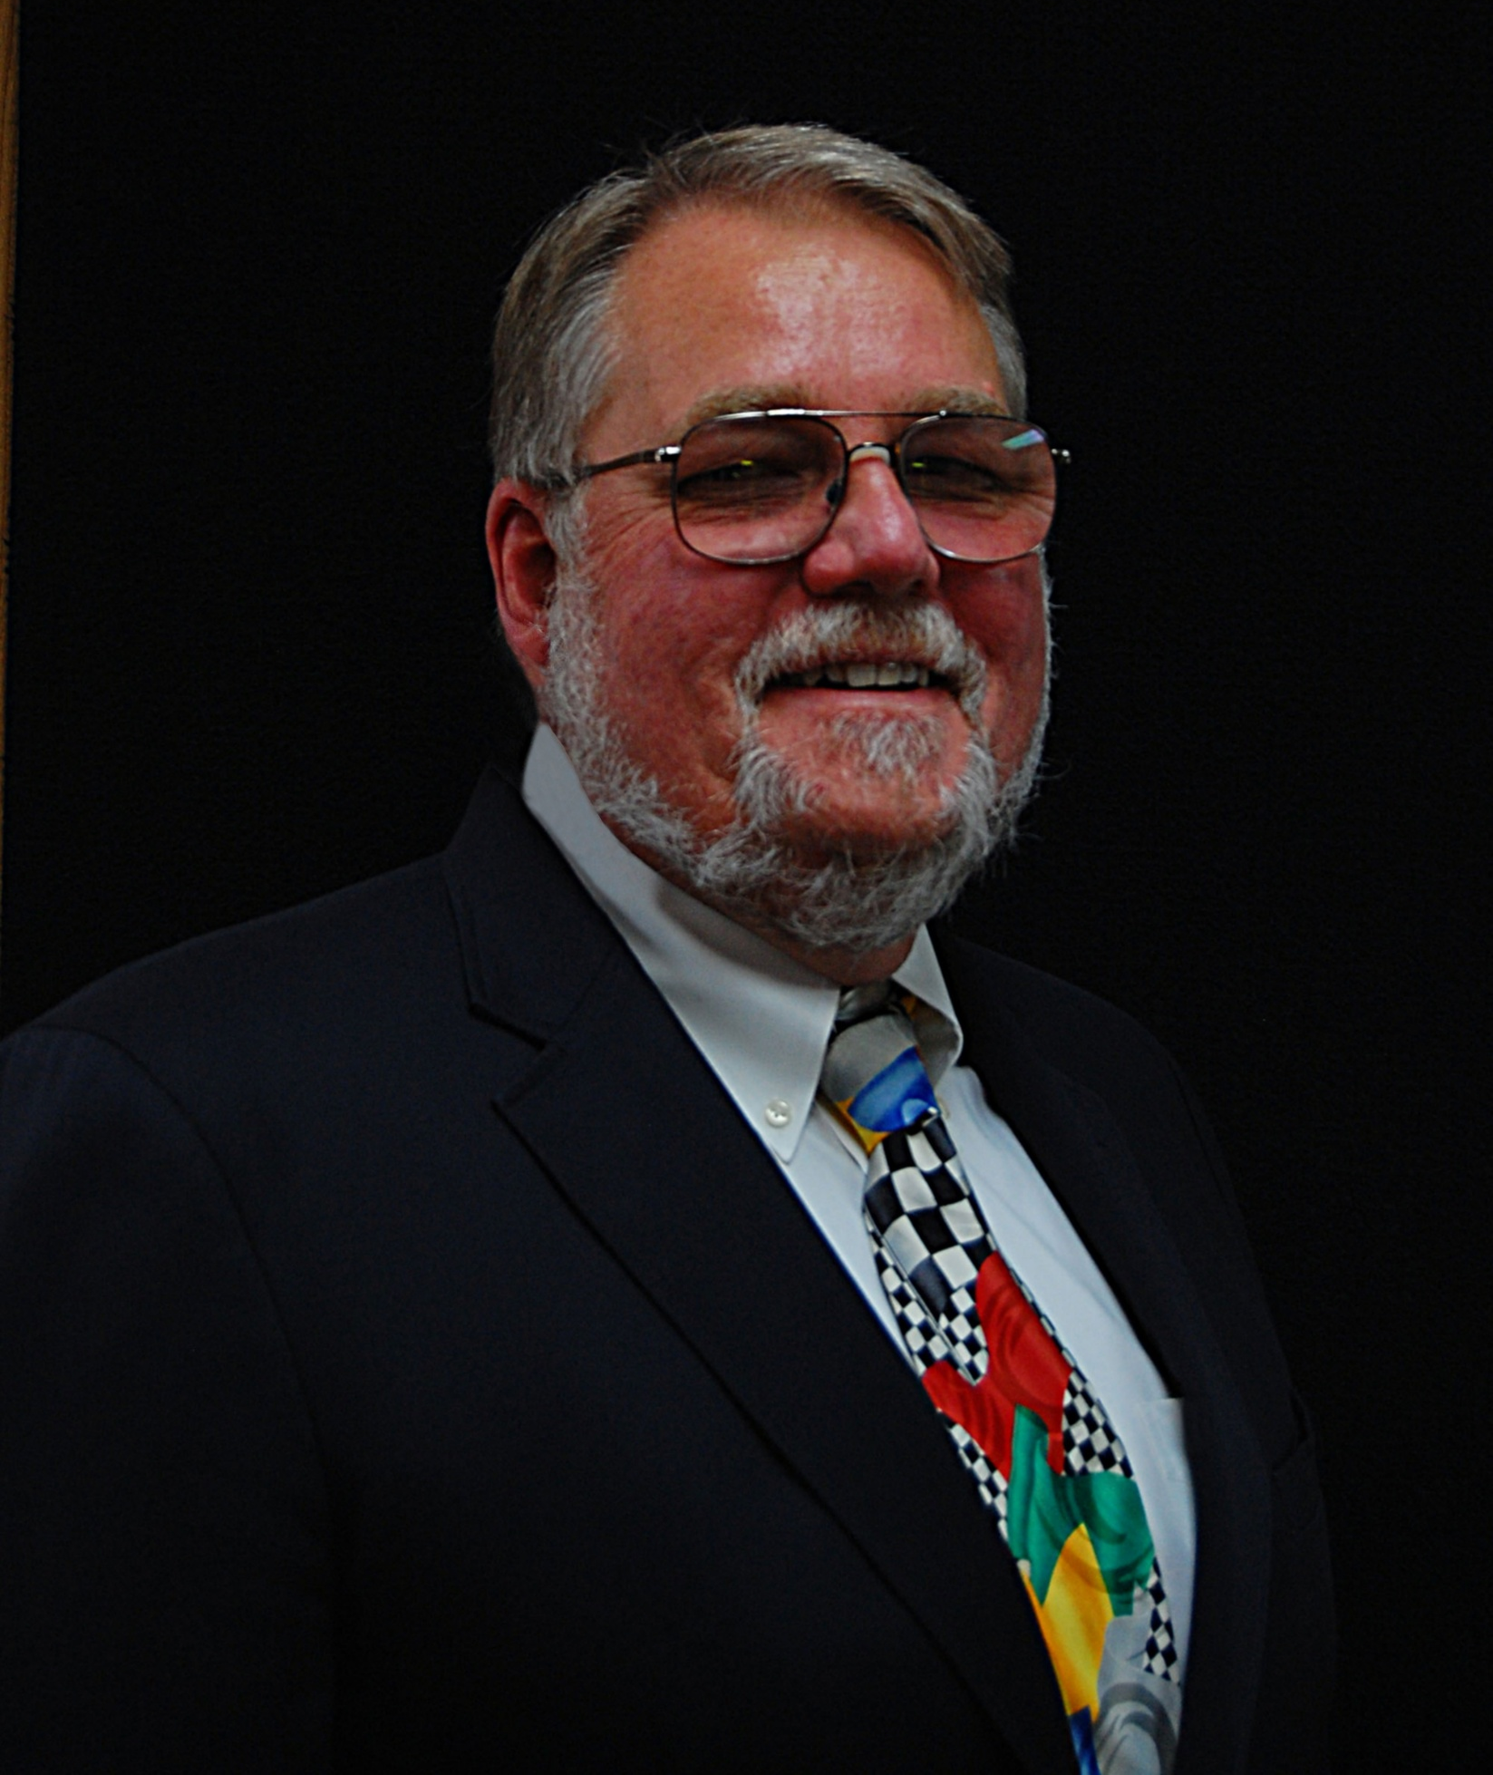
1:20 PM
Invited Talk: NATO Ground Vehicle Mobility – Implementation status of methods and technologies ensuring operational capability, deployed forces interoperability, improved survivability, and direct support to operational planners
Henry Hodges – President, Nevada Automotive Test Center (NATC)

Slide 5
2:20 PM
Adopting COTS Technologies for UGV Wheel Drive System
Ken May
Joao Costa
Jake Boyd

Slide 6

2:40 PM
Break + Outdoor Tech Demo: Dataspeed’s TWEEDLE UGV

Slide 7

Networking Reception
Join us for our networking reception!
5:15 – 7:15 PM
Outdoor Patio

